Slide 1
GOES-18 L2 (Group 1) Provisional Validation
Peer/Stakeholder Product Validation Review (PS-PVR)
Sept. 28, 2022
NWS Perspective: AWIPS verification
Clear Sky Mask | Cloud Top Temperature
Cloud Top Phase | Cloud Top Pressure
Cloud Top Height | Derived Motion Winds

Slide 2
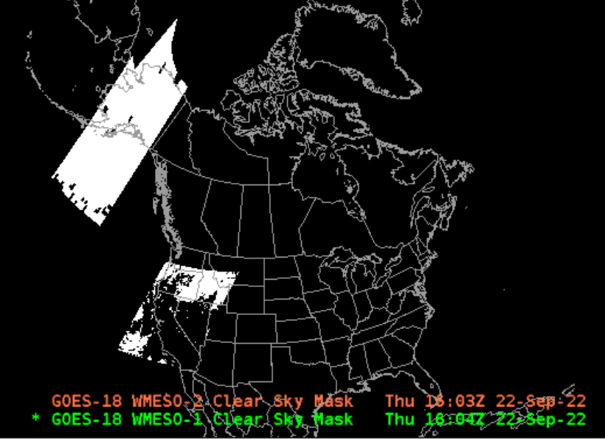
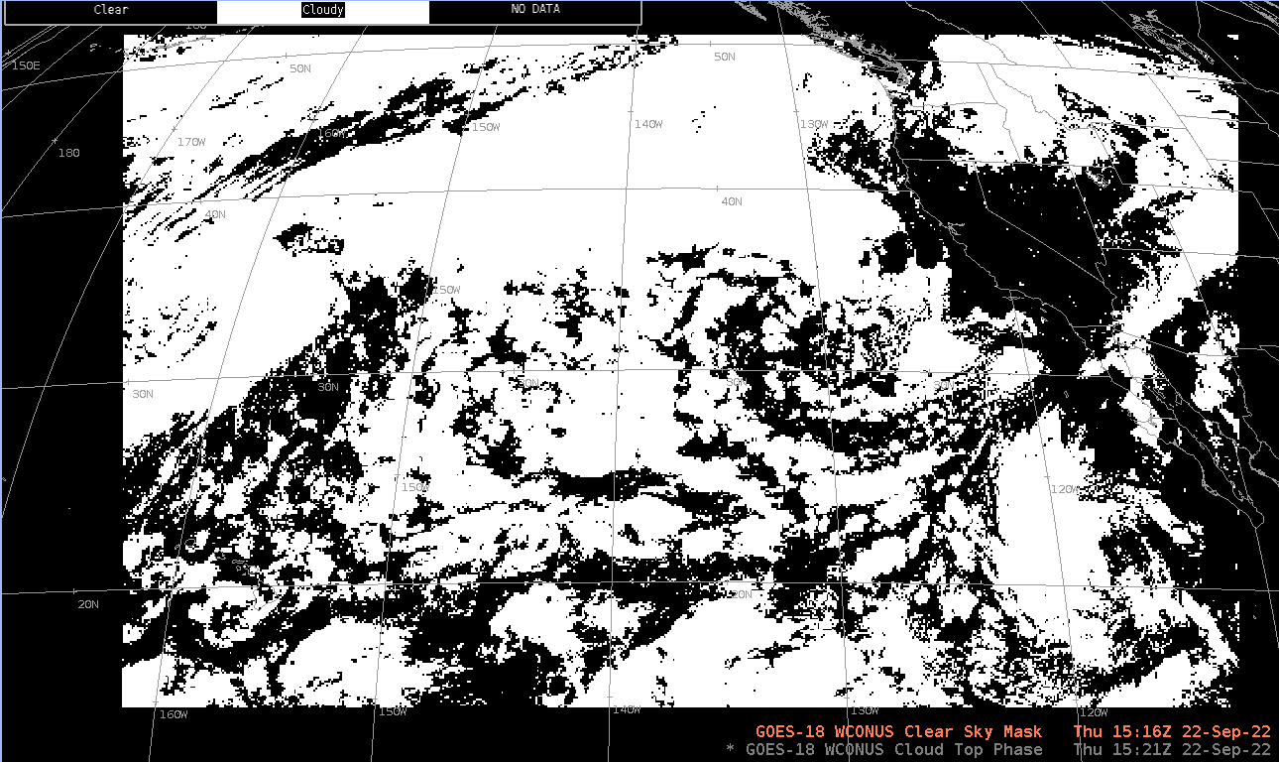
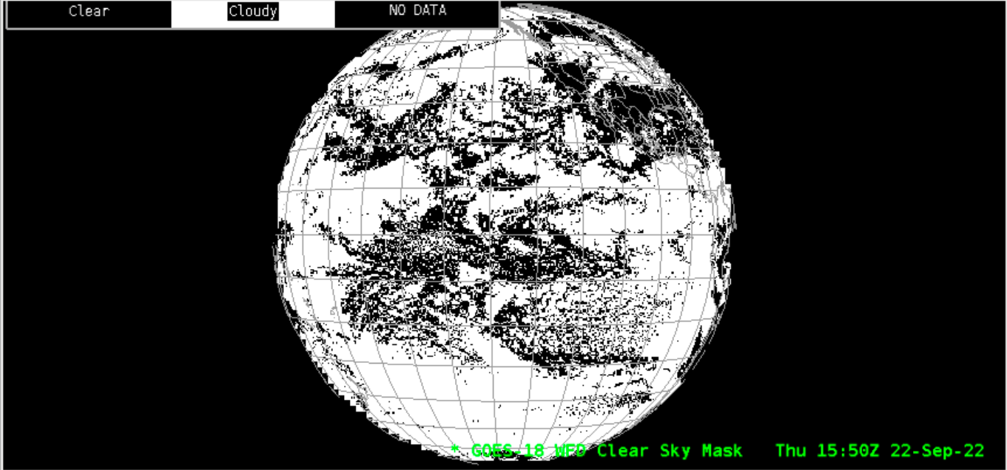
Clear Sky Mask

Slide 3
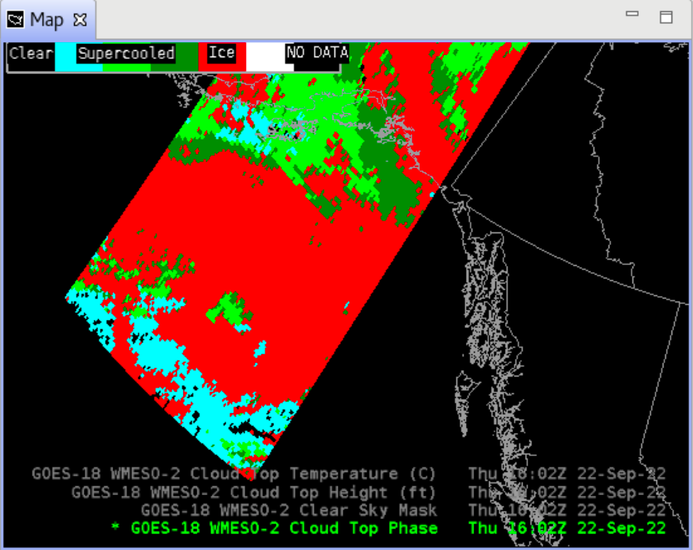
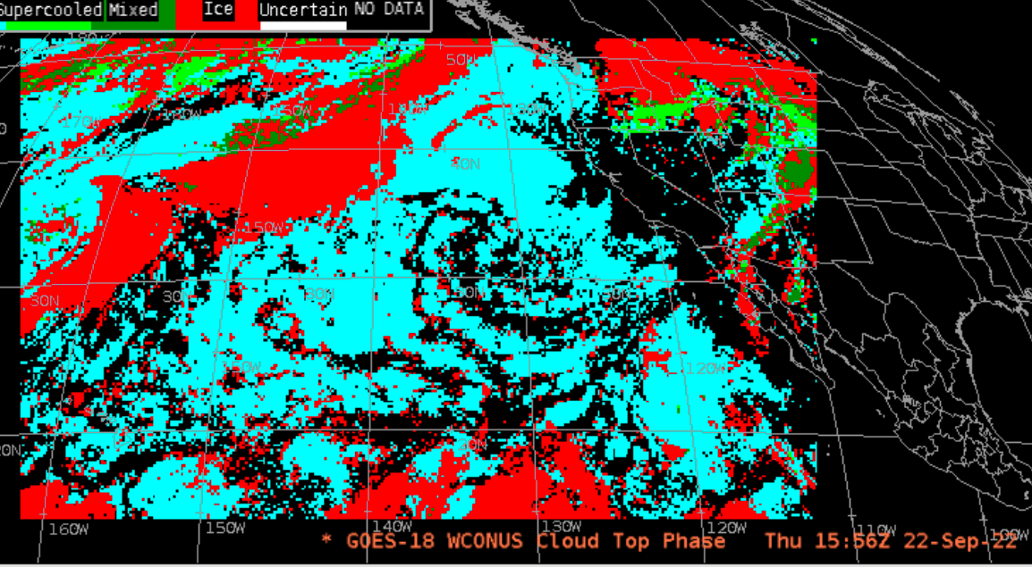
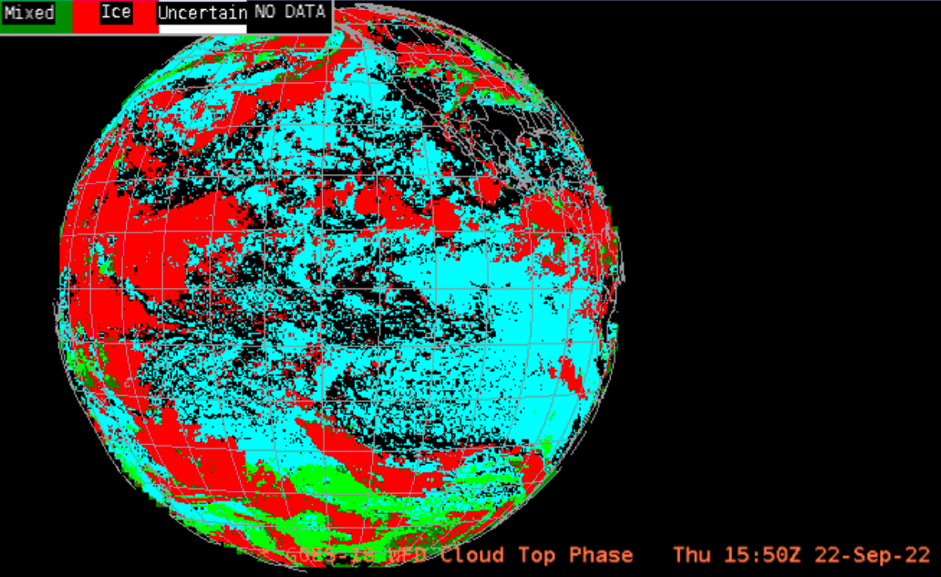
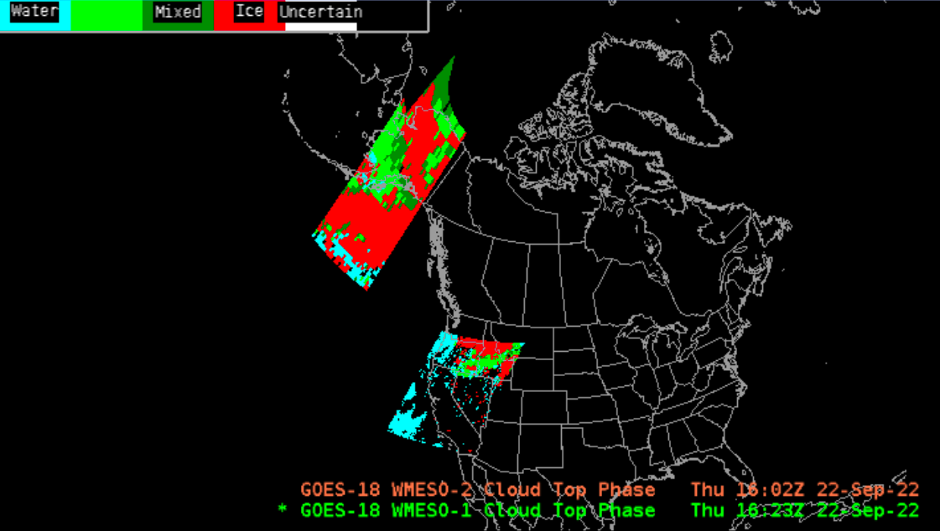
Cloud Top Phase

Slide 4
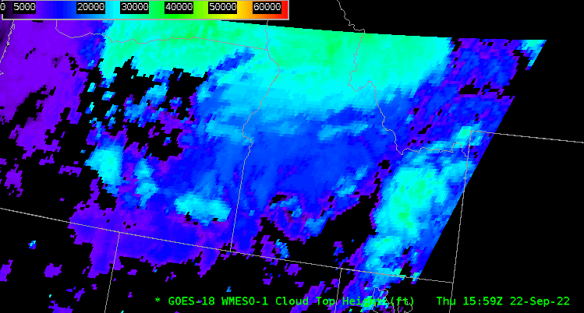
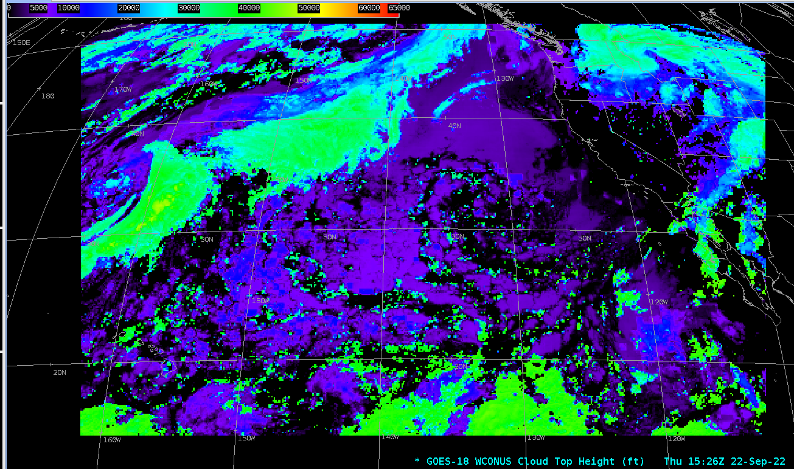
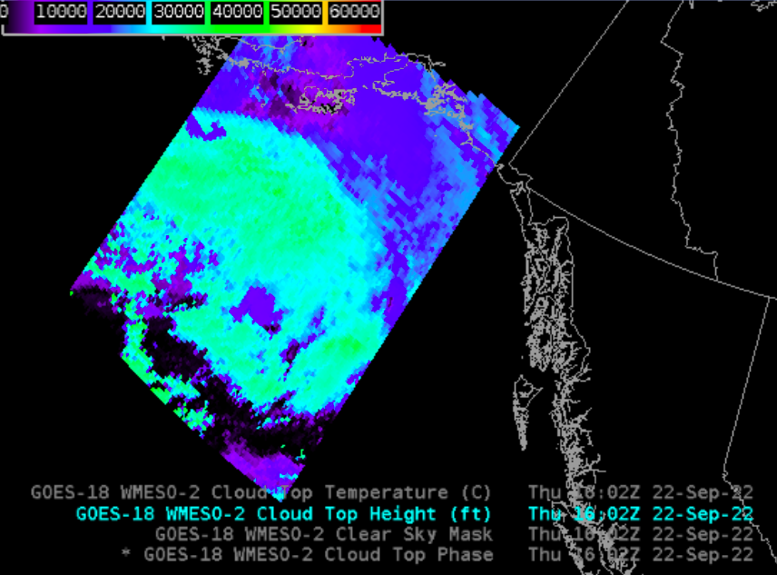
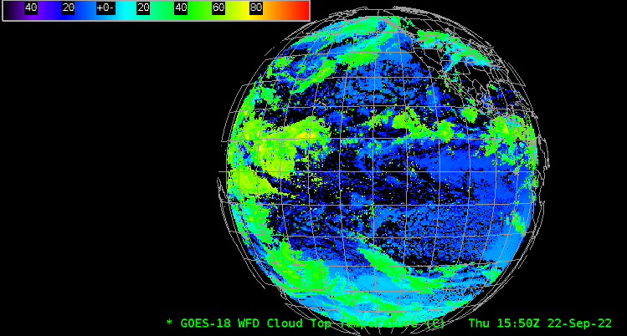
Cloud Top Height

Slide 5
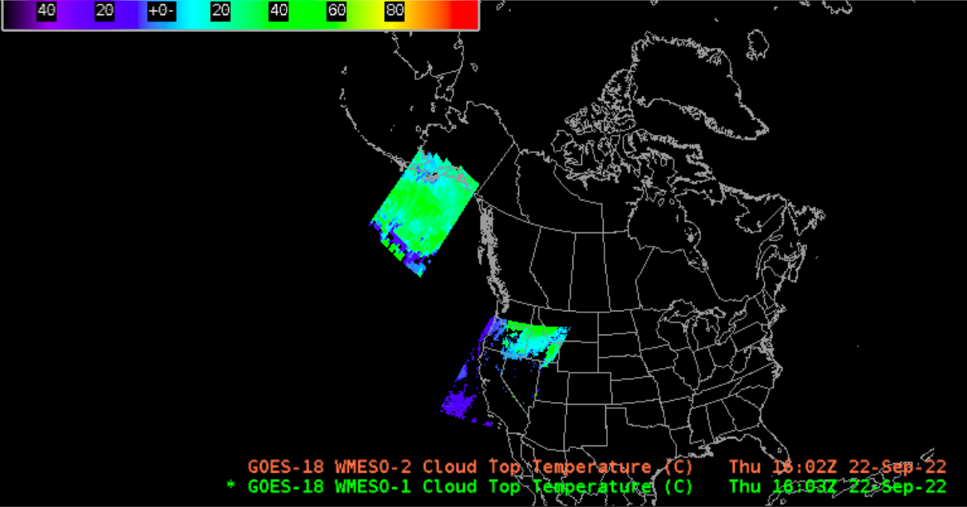
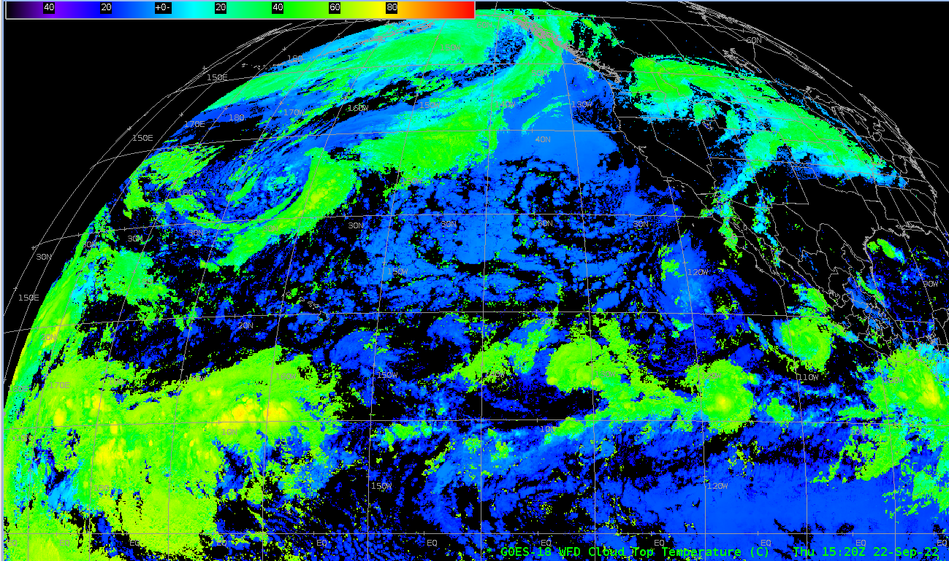
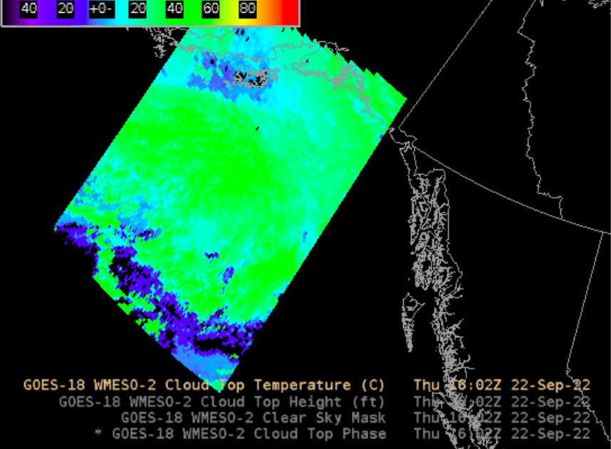
Cloud Top Temperature

Slide 6
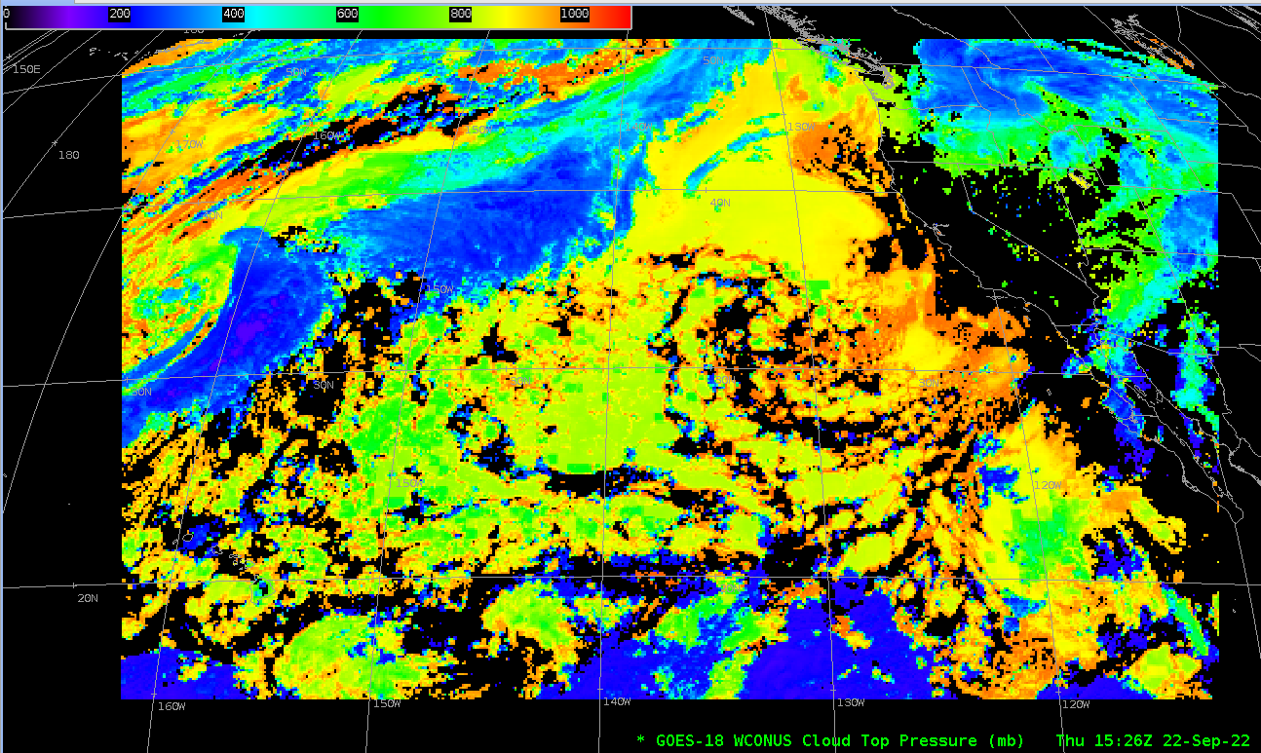
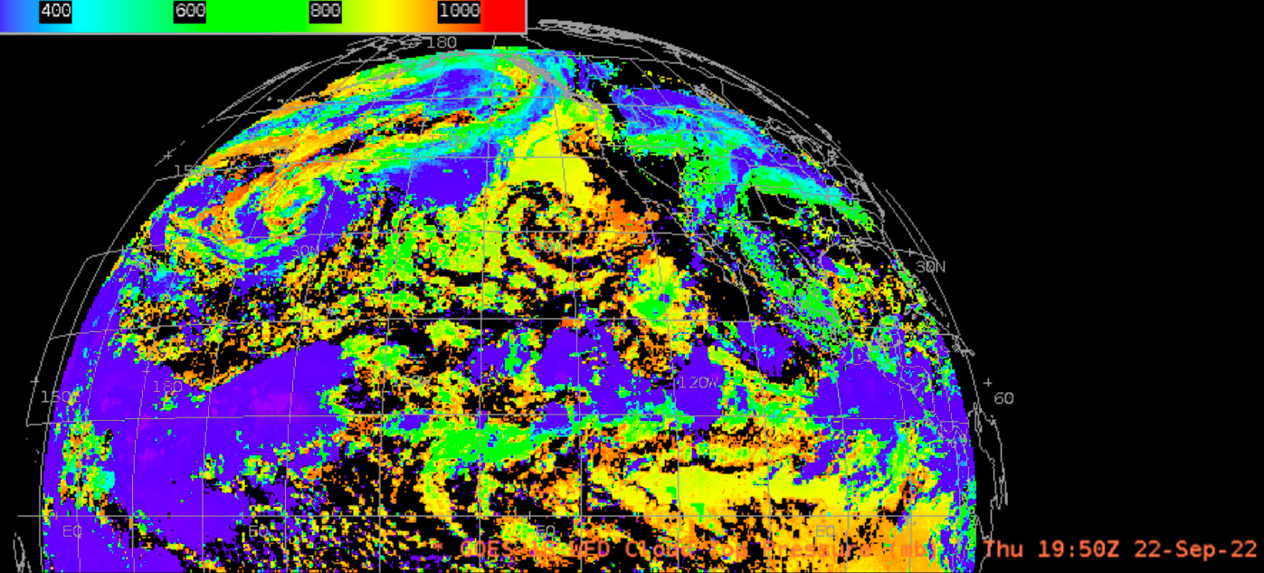
Cloud Top Pressure

Slide 7
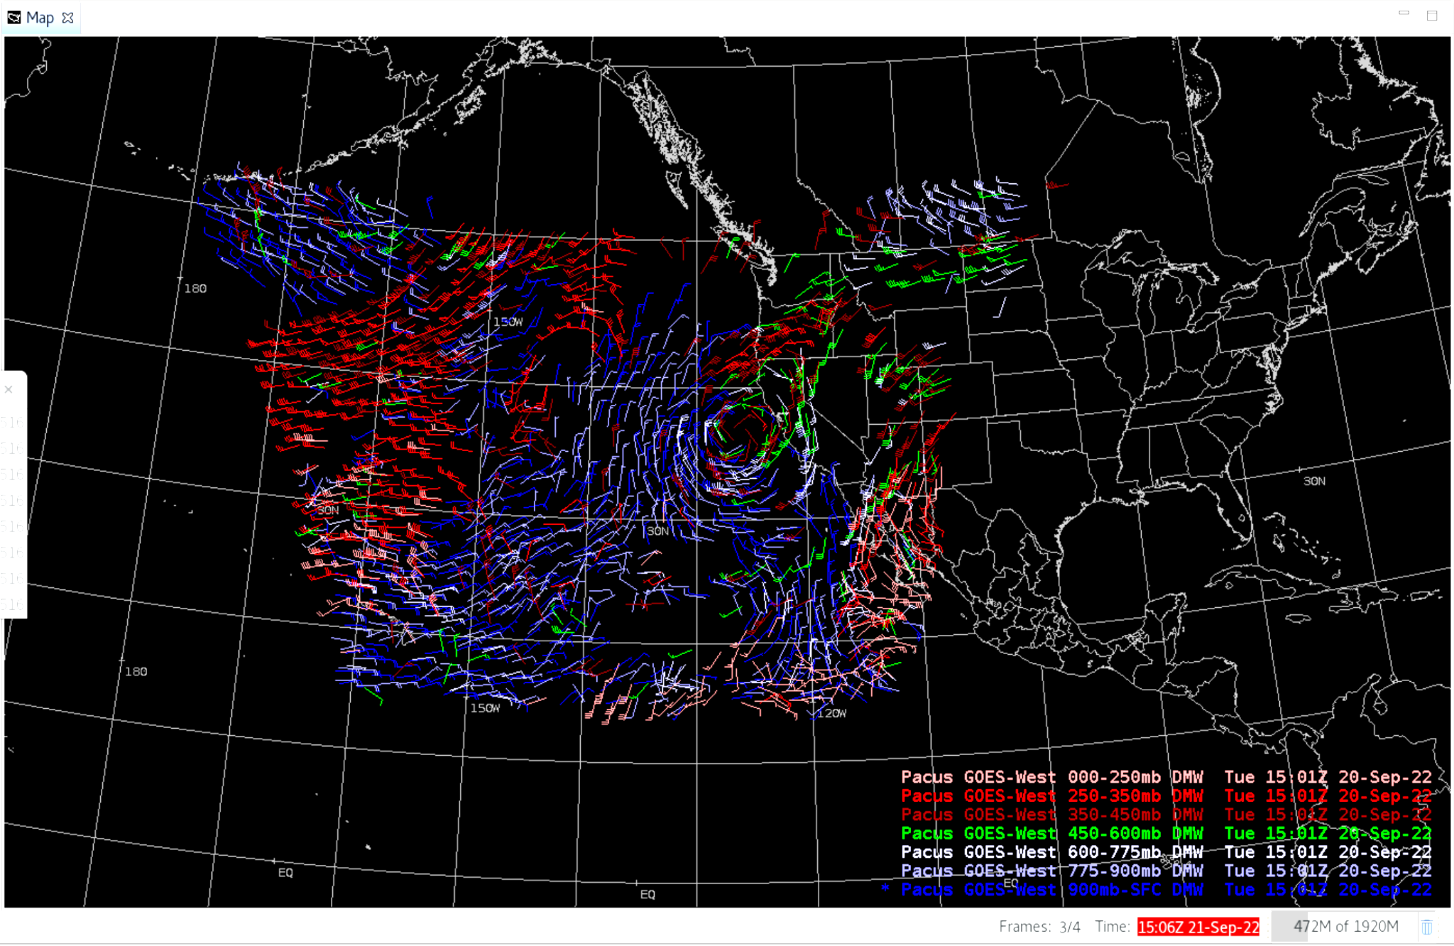
Derived Motion Winds

Slide 8
Notes
AWIPS ingests and displays all these products using its baseline configurations.
“No muss, no fuss” … words rarely heard around AWIPS
No fielding issues are expected
G-18 products conform closely to G-16,17 conventions (GOES-R Product User Guide)
AWIPS’ baseline configurations allowed for new GOES-R satellites

